Slide 1
PubMed MEDLINE Visualizer
What can I quickly learn about my disease of interest

Slide 2
MVP
Search PubMed with specific MeSH term (e.g. a disease – Zika Virus)
Select broad MeSH term or set of terms of interest to analyze (e.g. Georgraphy)
A suitable visualization is provided to user
Proof-of-concept: Jupyter notebook
Final MVP: web application

Slide 3
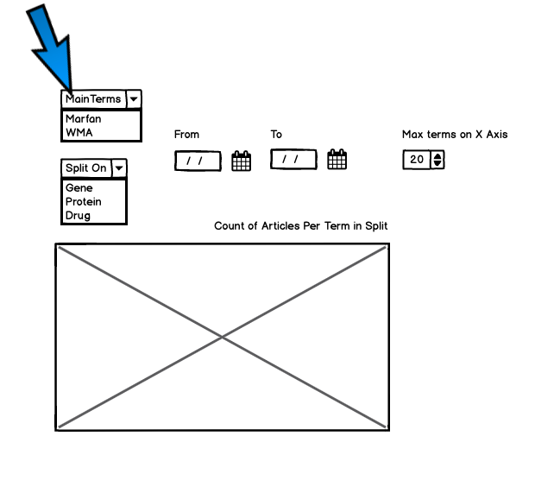
MVP Mockup

Slide 4
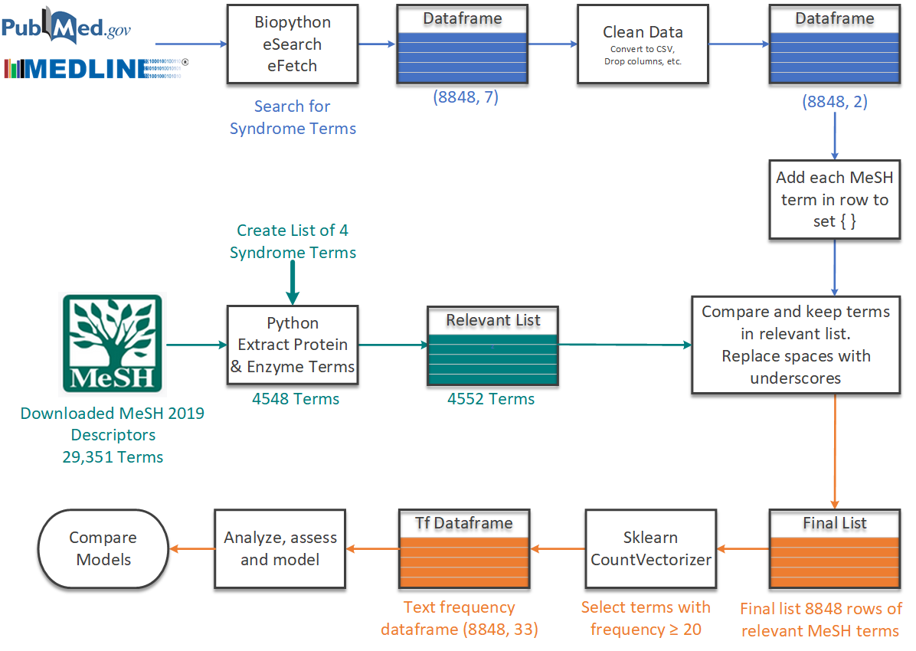
Workflow
Select MeSH or execute search using Biopython
Convert XML to DF and clean
Append MeSH terms and filter as needed
Plot Article Count vs Leaf nodes based on broad MeSH term
Sklearn CountVectorizer

Slide 5
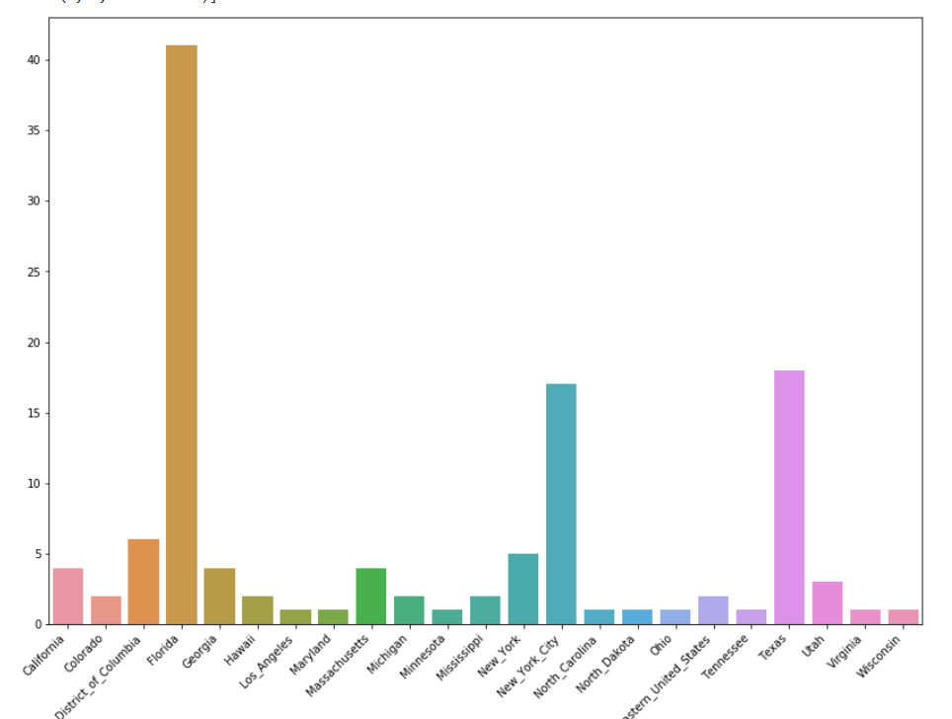
PubMed2Knowledge
Search PubMed with a specific term e.g. Disease: Zika virus infection
Use a broad category e.g. Geo terms like countries (and regions)
Generate a visualization:

Slide 6
Beyond MVP – What additional features
Search can be a pubmed search
Search can has fuzzy match on MeSH
Expand search capability to SCR
Multiple viz options/dashboarding

